Slide 1
Network Security
CS 5352/6352 Computer Security
Lecture note
Dr. Sajedul Talukder

Slide 2
Stages of a Cyber-Operation
Target Identification
Reconnaissance
Gaining Access
Hiding Presence
Establish Persistence
Execution
Assessment
Target Identification
Opportunistic Attack: focuses on any easy-to-break-into site
Targeted Attack: specific victim in mind
  Searches for a vulnerability that will work.

Slide 3
Reconnaissance
Target Identification
Reconnaissance
Gaining Access
Hiding Presence
Establish Persistence
Execution
Assessment
Reconnaissance
Scanning
  Network Mapping
  Port Scanning
  OS detection
  Vulnerability assessment

Slide 4
Hacking Networks
Reconnaissance Stage
Registrant:
Microsoft Corporation
One Microsoft Way
Redmond, WA 98052
US
Domain name: MICROSOFT.COM
Administrative Contact:
Administrator, Domain domains@microsoft.com
One Microsoft Way
Redmond, WA 98052
US
+1.4258828080
Technical Contact:
Hostmaster, MSN msnhst@microsoft.com
One Microsoft Way
Redmond, WA 98052 US
+1.4258828080
Registration Service Provider:
DBMS Ver iSign, dbms-support@verisign.com
Physical Break-In
Dumpster Diving
Google, Newsgroups, Web sites
Social Engineering
  Phishing: fake email
  Pharming: fake web pages
Whois Database & arin.net
Domain Name Server Interrogations
Notes:
Text on the right is an example of a ‘whois’ query. It is not a good idea to name the administrative contact.
News/web sites are useful for learning about different subsidiaries, staff names or positions, new merges (potentially with less security). Dumpster diving can sometimes produce internal documentation – use a shredder.

Slide 5
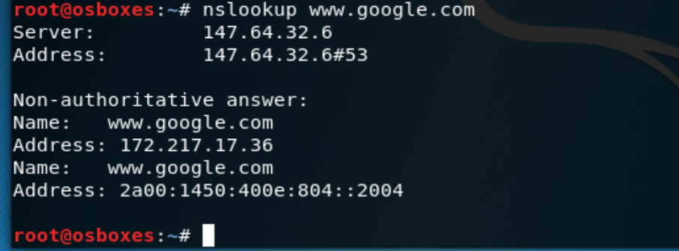
Hacking Networks
Reconnaissance Stage
nslookup
  $ nslookup eon.cs.ucr.edu
  $ nslookup eon.cs.ucr.edu momo.cs.ucr.edu
whois
  $ whois google.com
  $ whois ucr.edu
Notes:
After the cracker knows something about the company, often the second stage would be to learn the network and computer configurations.
War Driving: Listening with a high-powered receiver for wireless LAN signals. Tools indicate the power level, encryption type, and protocol details.
War Dialing: Dials numbers within a range looking for a modem to answer.
Network Mapping: Polls computers for which services they support
Vulnerability Scanning Tools: Polls computers to learn services, service versions, configurations

Slide 6
Hacking Networks
Reconnaissance Stage
War Dialing: Can I find a modem to connect to?
War Driving: Can I find a wireless network?
Network Scanning: What IP addresses, open ports, applications exist?
Protocol Sniffing: What is being sent over communications lines?
Notes:
After the cracker knows something about the company, often the second stage would be to learn the network and computer configurations.
War Driving: Listening with a high-powered receiver for wireless LAN signals. Tools indicate the power level, encryption type, and protocol details.
War Dialing: Dials numbers within a range looking for a modem to answer.
Network Mapping: Polls computers for which services they support
Vulnerability Scanning Tools: Polls computers to learn services, service versions, configurations

Slide 7
What Can We Scan For
Modems (and other telephone devices)
Live Hosts
TCP ports
UDP ports
Promiscuous NICs

Slide 8
War Dialing: Modems
Wardialing or war dialing is a technique to automatically scan a list of telephone numbers, usually dialing every number in a local area code to search for modems, computers, bulletin board systems (computer servers) and fax machines.
Repeatedly dial phone numbers looking for a modem to answer or other things
  War Dialers – used to find modems
    ToneLoc – 1994 by Minor Threat & Mucho Maas
      THC-Scan 2.0 – VanHouser, releaces by Hackers Choice
        thc.inferno.tusclum.edu
        Win9x, NT, W2000
        100 lines/hour
    TBA – LOpht (www.Lopht.com)
      War dialing on a PALM
  Demon Dialers – once a modem is found repeatedly dial it and guess passwords

Slide 9
Live Hosts
Try pinging (ICMP Echo request) all hosts on a particular subnet to see who replies
  No reply indicates host is not live
  Incoming ICMP messages are blocked
It’s a good idea to block incoming ICMP messages at the firewall
If no reply a hacker would try connecting to a commonly open port (TCP port 80) or sending a UDP packet to a commonly open port.
In java (which doesn’t do ICMP) send a ping using JNI to execute the ping command as an OS command line command.

Slide 10
Mapping your network
Once the live hosts are known, a map of your network can be arrived at by determining how the hosts are connected together
In computing, traceroute and tracert are computer network diagnostic commands for displaying the route (path) and measuring transit delays of packets across an Internet Protocol (IP) network.
traceroute (unix/linux) / tracert (w2000). By doing repetitive traceroutes to the hosts discovered in the host scan the network topology can be discovered.
Microsoft(R) Windows NT(TM)
(C) Copyright 1985-1996 Microsoft Corp.
C:\users>tracert mail.binghamton.edu
Tracing route to mail.binghamton.edu [128.226.1.18]
over a maximum of 30 hops:
1 <10 ms <10 ms <10 ms 128.226.121.1
2 <10 ms <10 ms <10 ms 128.226.100.25
3 <10 ms <10 ms <10 ms bingnet2.cc.binghamton.edu [128.226.1.18]
Trace complete.

Slide 11
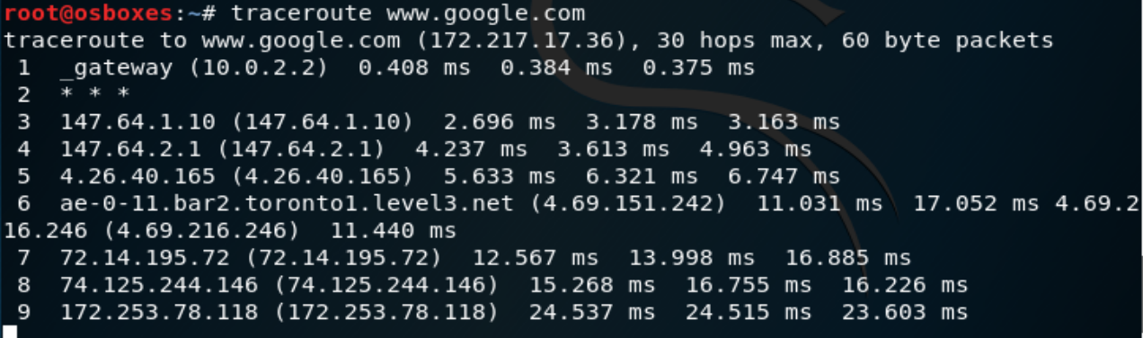
Traceroute example
traceroute <target host>

Slide 12
Port Scanning
Once the attacker knows the topology of your network the tedious task of identifying open ports and services starts
TCP and UDP scans are fine if you are scanning your own network looking for vulnerabilities but are to easily detectable for a hacker
Idea
  sending a message to each port, one at a time.
  Based on the type of response, an attacker knows if the port is used.
  The used ports can be probed further for weakness.
Nmap (www.insecure.org/Nmap)
  most versions of Unix
  ported to W/NT by eEye (www.eeye.com/html/Databases/Software/Nmapnt.html)
  does many types of scans

Slide 13

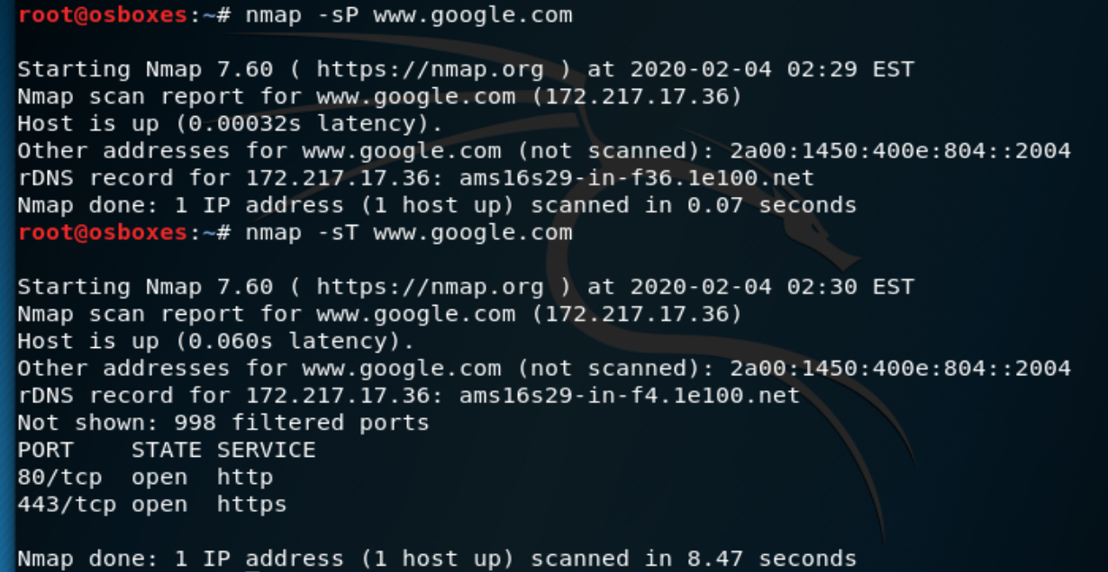
Scanning for Hosts
Is the host alive ?
Method
  Ping
    nmap –sP 192.168.0.1
  TCP Ping
    nmap –sT 192.168.0.1

Slide 14
TCP Flag Definitions
Flag
SYN | The beginning of a connection
ACK | Acknowledge receipt of a previous packet or transmission
FIN | Close a TCP connection
RST | Abort a TCP connection

Slide 15
Standard ports (0 - 1023)
  Assigned to services by IANA (internet assigned numbers authority)
  Only super-user is allowed to open the ports.
  Examples
    ftp-data 20/udp
    ftp 21/tcp
    ssh 22/tcp
    telnet 23/tcp
    Time 37/tcp
    Time 37/udp
    Whois 43/tcp
    http 80/tcp
    Imap 143/tcp

Slide 16
Port Scanning
TCP Connect - completes 3-way handshake
TCP SYN - sends only initial SYN and waits for SYN-ACK
TCP FIN - send TCP FIN to each port, reset indicates port is closed; violates the protocol
TCP Xmas Tree - Sends packet with FIN, URG, PUSH set; reset indicates port is closed, no resp. may mean port is open. This actually violates the protocol; doesn’t work on Windows machine as MS didn’t follow the RFC
NULL - send packet with no code bits set, reset indicates port closed;
TCP ACK - Send a packet with ACK bit set, helps determine a packet filter’s rules
Window - similar to ACK scan but focuses on TCP window size to determine if ports are open or closed

Slide 17
TCP connect() Scan
TCP connect() scanning
  The most basic form of TCP scanning
  The connect() system call provided by the OS is used to open a connection to every interesting port on the machine.
  If the port is listening, connect() will be succeed.
  Otherwise, the port isn’t reachable.
With connect() call used by the operating system to initiate a normal TCP connection to a remote device (3-way handshake)
No need of any special privileged access: Any user can use it.
TCP connect scan is often logged by target host service.

Slide 18
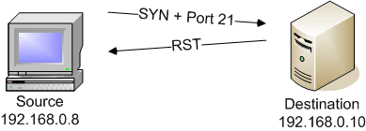
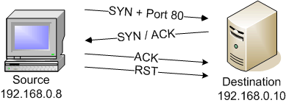
TCP connect() Scan
Closed Port:
  Like the TCP
  SYN scan
Open Port:
  completes the TCP
  3W-Handshake (3WHS).
  Then sends RST.
Notes:
RST – Reset
TCP connect() scan completed the 3 way handshake and then immediately sent a rest (RST) packet to close the connection.

Slide 19
TCP connect() Scan
Nmap –sT <target host>
Connect
Nmap
Host
Empty UDP Packet
ICMP
unreachable

Slide 20
TCP SYN Scan/Half-Open Scan
Often referred to as half-open scanning.
  Not to open a full TCP connection.
Send a SYN packet, as if a real connection is open.
Then wait for a response.
  A SYN/ACK indicates the port is listening.
If a SYN/ACK is received, send an RST to tear down the connection immediately. (kernel will do this for you).
The primary advantage to this scanning technique is that fewer sites will log it.
But you need root privileges to build these custom SYN packets.
Notes:
Root – admin privilage

Slide 21

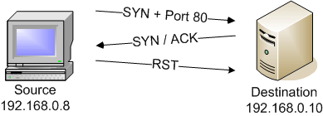
TCP SYN Scan/Half-Open Scan
Closed Port:
  No difference with TCP connect scan
Open Port:
  SYN/ACK: port is open
  SYN/ACK then RST
Notes:
Common scan when open ports on a remote device. It only half opens the TCP connections.

Slide 22
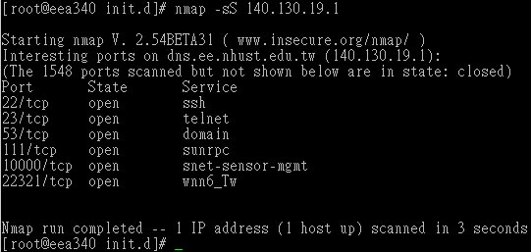
TCP SYN Scan/Half-Open Scan
Nmap –sS <target host>
Nmap sends to Host Port | Nmap receives from Host Port | Nmap Assumes
SYN | SYN/ACK | Port is open Host is up
SYN | RST | Port is closed Host is up
SYN | Nothing | Port is blocked by firewall Or Host is down

Slide 23
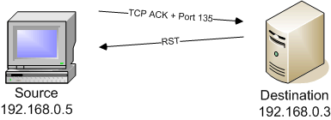
TCP ACK Scan
Random TCP ACK sent to destination
  If active, RST is returned If not active or the port is filtered, no response to the ACK
  Useful to see if a firewall is stateful or simple
Requires privileged access or send TCP connect(). Port 80 is used by default:
  filtered connection
Notes:
No response means port is filtered.

Slide 24
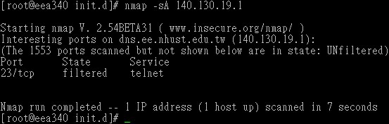
TCP ACK Scan
Nmap –sA <target host>
Nmap sends to Host Port | Nmap receives from Host Port | Nmap Assumes
ACK | RST | Port is not firewall-protect Port may be open or closed Host is up
ACK | Nothing or ICMP unreachable | Port is blocked by firewall if host is up

Slide 25
TCP FIN Scan
Send a FIN (finish) packet without SYN
  For when trying to hide from SYN loggers
  Requires Root privileges to create raw TCP packet
Some firewalls and packet filters watch for SYNs to restricted ports.
FIN packets may be able to pass through.
Closed ports tend to reply to FIN packet with proper RST.
Open ports tend to ignore the packet in question.
FIN may be dropped by firewall/pass through:
  no differentiation with open port

Slide 26
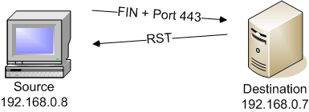
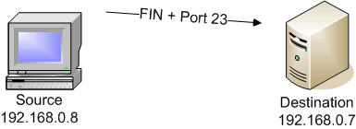
TCP FIN Scan
Closed Port:
  Reply with RST
Open Port:
  No reply to FIN
Notes:
Identifies TCP ports

Slide 27
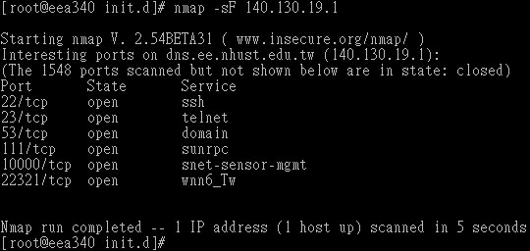
TCP FIN Scan
Nmap –sF <target host>
Nmap sends to Host Port | Nmap receives from Host Port | Nmap Assumes
FIN | RST | Port is closed Host is up
FIN | Nothing | Port is open if host is up and not firewall-protected
Connect
Nmap
Host
FIN
RST

Slide 28
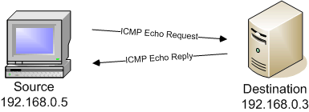
ICMP Ping Scan
ICMP echo (ping) request to destination IP @
  If an ICMP echo reply (pong) received, station is active
  If no response -station not active or connection is filtered
  ICMP does not have
  a notion of port
  numbers, it has types
  and codes
Notes:
@ means address

Slide 29
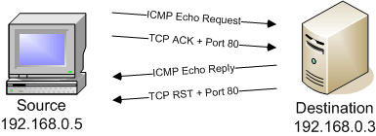
ICMP Echo & TCP ACK
ICMP echo request + TCP ACK
Response if system alive & if port 80 not filtered

Slide 30
FTP Bounce Scan
Take advantage of a vulnerability of FTP protocol.
Requires support for proxy ftp connections.
For example, evil.com can establish a control communication connection to FTP server-PI (protocol interpreter) of target.com.
Then it is able to request the server-PI to initiate an active server-DTP (data transfer process) to send a file ANYWHERE on the internet.
A port scanner can exploit this to scan TCP ports from a proxy ftp server.
Connect to an FTP server behind a firewall, and then scan ports that are more likely to be blocked.
If the ftp server allows reading from and writing to a directory (such as /incoming), you can send arbitrary data to ports that you do find open.

Slide 31
FTP Bounce Scan
Advantages
Use a FTP vulnerability: proxy
No required privileges., Harder to trace, Potential to bypass firewalls.
Disadvantages
Requires a third host as proxy for FTP (passive)
  Must be logged in. Slow, Many FTP servers have disabled the proxy features
  Either Anonymous or User,
  User sends PORT command to FTP server that redirects data towards different target host/port!
User can send arbitrary data to open ports
  Don’t accept connections from your FTP server
  Many FTP servers disable proxy
  This technique can be generalized to e.g. SMTP (spam)

Slide 32
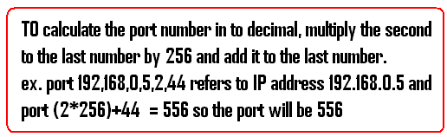
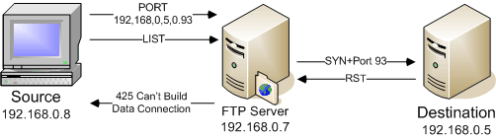
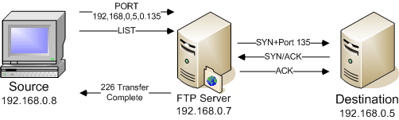
FTP Bounce Scan
Closed Port:
  Send Port(IP@+Port)
  + List (launch data connection)
  (or PUT to send arbitrary data)
  FTP server can’t build the connection
Open Port:
  FTP Transfer is
  completed

Slide 33
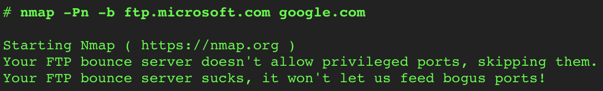
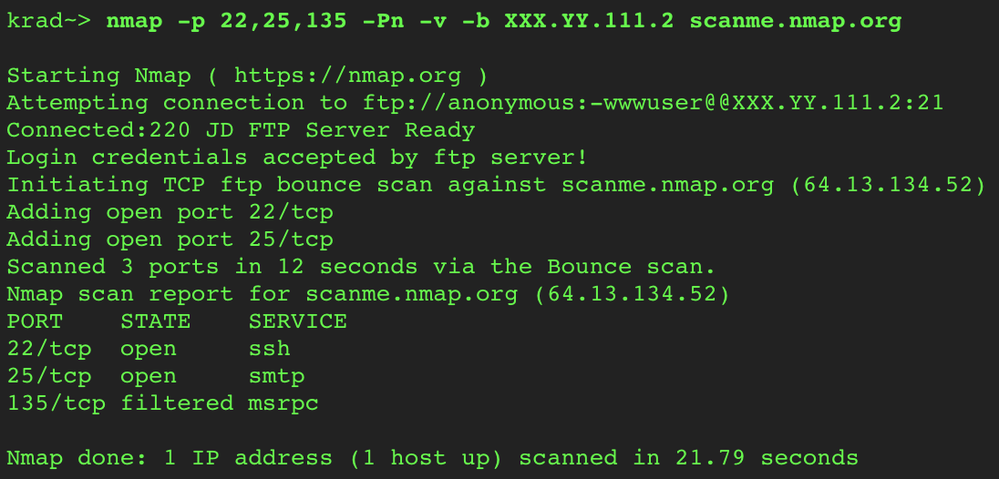
FTP Bounce Scan
Failed Scan
Successful Scan

Slide 34
UDP Scan
UDP ICMP port unreachable scanning
  UDP protocol instead of TCP
  Protocol is simpler, but the scanning is more difficult
    Open ports don’t have to send an acknowledgement.
    Closed ports aren’t even required to send an error packet.
  Most hosts do send an ICMP_PORT_UNREACH error when you send a packet to a closed UDP port.
    Can find out if a port is NOT open.
  Neither UDP packets, nor the ICMP errors are guaranteed to arrive.
    Retransmission of packets is required for packets that appear to be lost
    Otherwise, we will have many false positives.
  Disadvantages
    Slow: the ICMP error message rate is limited.
    Need to be root for access to raw ICMP socket.

Slide 35
UDP Scan
Scan is more difficult
  No ACK from open ports
  Most host send an ICMP_ Port_ Unreached error when you send a packet to a closed UDP port.
Reading ICMP packets requires root privileges
Can find out if system is alive
If ICMP is filtered, no response to UDP ping

Slide 36
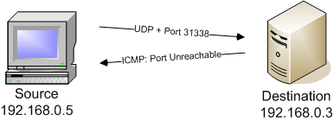
UDP Ping Scan
Closed Port:
  UDP ping,
  If ICMP Port Unreachable
  system is alive
Open Port:
  If no response: remote system unavailable.
  Could be incorrect because UDP applications don’t necessarily send a response to empty requests
Notes:
UDP Scan : This type of Scanning is used to determine which UDP ports are open on the target host. In this type of scanning 0 byte udp packet it send to all the specified ports on the taget machine and if we get ICMP unreacheable then the port is assumed to be closed or else it is considered as open. But to its demerit is that sometimes ISP’s often block these ports and so it sometimes throws incorrect results that the ports are open but infact it is not, so you need to be a bit more fortunate about these results.

Slide 37
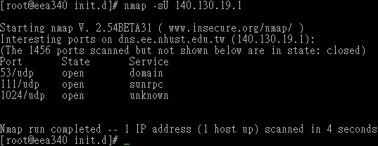
Scanning for UDP Ports
Nmap –sU <target host>
Nmap sends to Host Port | Nmap receives from Host Port | Nmap Assumes
Empty UDP packet | Nothing | Port assumed open if host responds to Ping. Port may be closed if firewall blocking ICMP
Empty UDP packet | ICMP unreachable | Port is closed
Connect
Nmap
Host
Empty UDP Packet
ICMP
unreachable

Slide 38
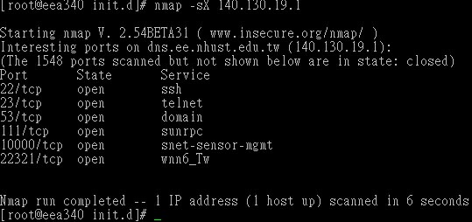

Xmas Scan/Null scan
Nmap –sX <target host>
Nmap –sN <target host>
Nmap sends to Host Port | Nmap receives from Host Port | Nmap Assumes
Empty TCP packet | Nothing | Port assumed open or filtered
Empty TCP packet | TCP RST packet | Port is closed
Empty TCP packet | ICMP unreachable error | Port is filtered
Connect
Nmap
Host
Empty UDP Packet
ICMP
unreachable

Slide 39
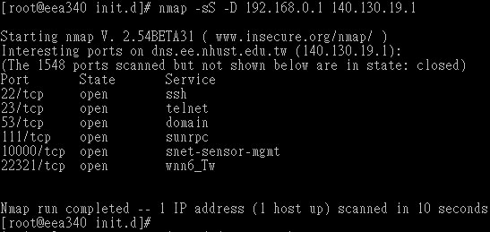
Stealth Scan
Nmap –sS <target host>
Simple port scanning can be easily logged by the services listening at the ports.
  E.g. they see an incoming connection with no data, thus they log an error.
Stealth scan refers to some scanning techniques to avoid being logged.
These techniques include fragmented packets, syn scanning, fin scanning etc.

Slide 40

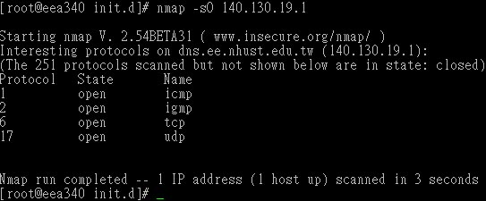
Scanning for Protocol
Nmap –sO <target host>

Slide 41

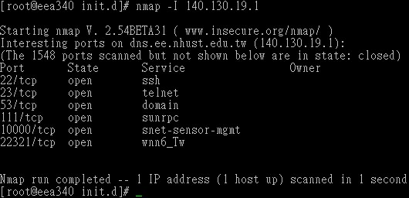
TCP Reverse Ident Scanning
Who runs the process (-I)
Nmap –I <target host>

Slide 42

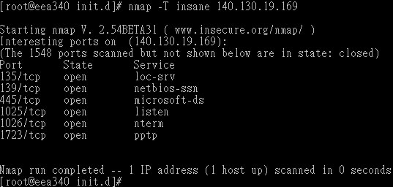
Timing Your Scan
Nmap –T <name> <target host>
name | Probe Response Timeout | Time Spent on One Host | Time between Probes
Paranoid (T0) | 5 min | Unlimited | 5 min
Sneaky (T1) | 15 sec | Unlimited | 12 sec
Polite (T2) | 6 sec | Unlimited | 0.4 sec
Normal (T3) | 6 sec | Unlimited | None
Aggressive (T4) | 1 sec | 5 min | None
Insane (T5) | 0.3 sec | 75 sec | None

Slide 43
OS Fingerprinting
Identification of the operating system running on a remote machine
Different kernels perform differently
  TCP options
  Initial sequence number
  ICMP error messages
  IP fragment overlap
Notes:
requires open port on machine
protocol stacks implemented differently
stacks change over time in one vendor
nmap sequence of 7 TCP & 1 UDP packet sent to open port
test idiosyncracies of the protocol stack
earlier example of windows RST to bare FINs is an example
when a protocol stack is updated/repaired, helps differentiate between versions of that OS
types of sensors
response to fin
response to tcp reserved flags
initial sequence number
don’t fragment bit
initial window size
ack value in response to xmas packets
icmp error message quenching RFC 1812
icmp error message quotiong
size
data scratch area
handling of ip fragment overlap
tcp options
not implemented by all systems
test supported set of options
test ordering of options in header
syn flood resistance
next: examples

Slide 44


OS Fingerprinting
With –O flag
Nmap –T <name> <target host>
Sending specially TCP and UDP headers
Analyze the result and compare information
OS information

Slide 45
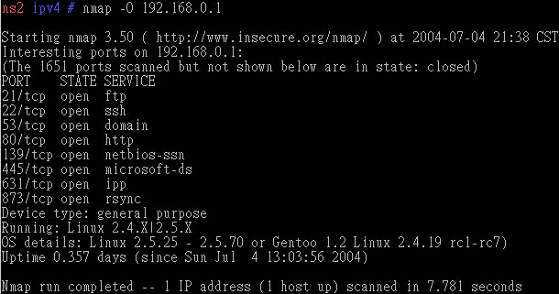
OS Detection on Linux
Nmap –O 192.168.0.1

Slide 46
Version Scanning
With –V flag
Nmap –V <target host>

Slide 47
All Options Scanning
With –A flag (Enable OS detection, version detection, script scanning, and traceroute)
Nmap –A <target host>

Slide 48
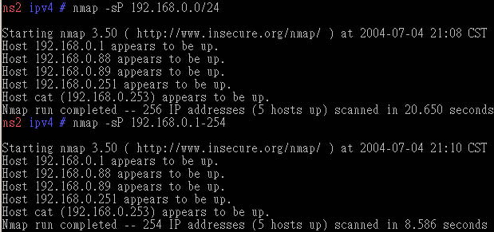
Mapping Networks
Scanning a Class C subnet

Slide 49
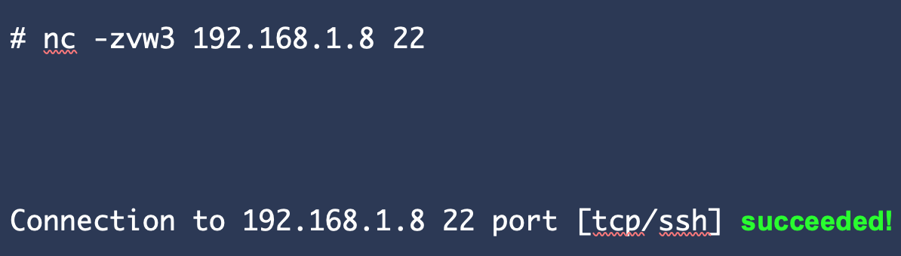
Netcat Scanning
nc [-options] [HostName or IP] [PortNumber]
z: zero-I/O mode (used for scanning).
v: For verbose.
w3: timeout wait seconds
192.168.1.8: Destination system IP.
22: Port number needs to be verified.

Slide 50
Telnet Scanning
telnet <host> port
telnet 38.76.11.19 22

Slide 51
Anatomy of a Portscan
Scan footprint
  Set of IPs and ports scanned
  Defines attacker’s information gathering requirements
Horizontal scan
  Scan same port across multiple machines
  Idea: attacker has an exploit for this particular service
Vertical scan
  Scan multiple ports on a single machine
  Idea: looking for vulnerable services on a specific machine
Notes:
horizontal scan example: the ftp portscan a few slides back

Slide 52
What is X Window?
X window is the program that draws windows on the screen under most GUI-based versions of UNIX. It is important to note that the language that X windows speaks is completely different from that of Microsoft Windows or Mac OS X.
Any X window system consists of 2 distinct parts - the X server and 1 or more X clients.
  The server controls the display directly, and is responsible for all input/output via the keyboard, mouse or display.
  The clients, on the other hand, do not access the screen directly - they communicate with the server, which handles all input and output.
    It is the clients which do the "real" computing work - running applications or whatever.
    The clients communicate with the server, causing the server to open one or more windows to handle input and output for that client.

Slide 53
X Window Server and Client
The X window server runs on the machine to which the monitor is connected.
The clients may also run on this machine, communicating directly with the server. On most workstations, this is the normal situation. However, X is a networked window system, and it is possible for the client to run on a remote machine, communicating with the server via some form of network.
It is possible to connect to one of the EU servers and launch graphical applications from one of the UNIX servers.
  This does require that an X window server is installed on the machine from which you are connecting from. This is automatically running if you are running a GUI UNIX system.
  You can also install an X window server on top of Microsoft Windows, so that you can open up windows locally that are talking to the server at UMBC. Like I said earlier, this does require installing some software on the client side, and time permitting we may talk about this later in the course.

Slide 54
Passive Attacks
Eavesdropping: Listen to packets from other parties = Sniffing
Traffic Analysis: Learn about network from observing traffic patterns
Login: Ginger Password: Snap
Jennie
Packet A
B
Carl
C
Bob
Notes:
Network Mapping = Footprinting, same as on previous page.
Traffic Analysis: Does a lot of traffic go between Point A and Point B, or Point C? Is it encrypted? This might be a concern if you are the military.

Slide 55
Network Analysis and Sniffing
Process of capturing, decoding, and analyzing network traffic
  Why is the network slow
  What is the network traffic pattern
  How is the traffic being shared between nodes
Also known as
  traffic analysis, protocol analysis, sniffing, packet analysis, eavesdropping*, etc.
*Listen secretly to what is said in private!

Slide 56
Who Uses Network Analyzers
System administrators
  Understand system problems and performance
Malicious individuals (intruders)
    Capture cleartext data
    Passively collect data on vulnerable protocols
      FTP, POP3, IMAP, SMATP, rlogin, HTTP, etc.
      Capture VoIP data
    Mapping the target network
    Traffic pattern discovery
    Actively break into the network (backdoor techniques)

Slide 57
Promiscuous Mode
Ethernet traffic is broadcasted to all nodes on the same segment
Sniffer can capture all the incoming data when the NIC is in promiscuous mode:
  ifconfig eth0 promisc
  ifconfig eth0 –promisc
  Default setup is non-promiscuous (only receives the data destined for the NIC)
  Remember: a hub receives all the data!
If switches are used the sniffer must perform port spanning
  Also known as port mirroring
  The traffic to each port is mirrored to the sniffer

Slide 58
Tools Overview
Tcpdump
  Unix-based command-line tool used to intercept packets
    Including filtering to just the packets of interest
  Reads “live traffic” from interface specified using -i option …
  … or from a previously recorded trace file specified using -r option
    You create these when capturing live traffic using -w option
Tshark
  Tcpdump-like capture program that comes w/ Wireshark
  Very similar behavior & flags to tcpdump
Wireshark
  GUI for displaying tcpdump/tshark packet traces

Slide 59
Tcpdump
Syntax:
tcpdump [options] [filter expression]
Unfortunately, linux machine does not allow normal users to run tcpdump
  $ sudo tcpdump –i eth0
    Sudo command allows you to run tcpdump in root privilege
  On your own Unix machine, you can run it using “sudo” or directly run “tcpdump” if you have root privilege
List interfaces: sudo tcpdump -D
Notes:
Depending on the kind of traffic, make some general observations – sources, destinations, kinds of traffic, DNS requests etc. Too much of output.

Slide 60
Tcpdump example
Ran tcpdump on a Unix machine
First few lines of the output:

Slide 61
Tcpdump Output
Output:
08:41:13.729687 IP 192.168.64.28.22 > 192.168.64.1.41916: Flags [R.], seq 196:568, ack 1, win 309, options [nop,nop,TS val 117964079 ecr 816509256], length 372
Timestamp Protocol IP.Port_{src} > IP.Port_{dest} : Flags[], Sequence #, Acknowledge #, Window size, Options, Length
Notes:
Depending on the kind of traffic, make some general observations – sources, destinations, kinds of traffic, DNS requests etc. Too much of output.

Slide 62
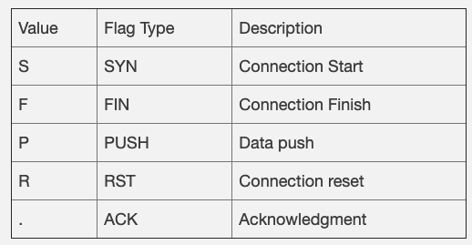
TCP Flags
Flags [R.]

Slide 63
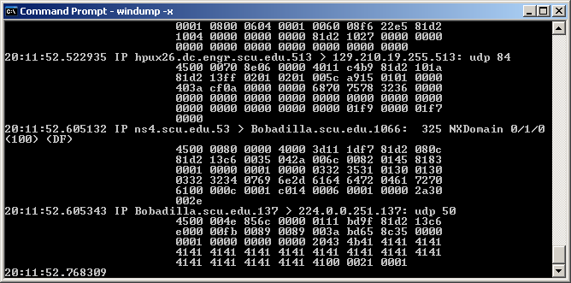
TCPDump Hex Output
tcpdump –x looks at packages in hex format
IP Header
ICMP Header
tcpdump –x
20:20:55.778140 IP dhcp-19-211.buba.cs.edinboro.edu > cs.edinboro.edu : icmp 108: echo request seq 4864
4500 0080 0231 0000 8001 0d0f 81d2 13d3
81d2 13c6 0800 d5ee 0200 1300 6162 6364
6566 6768 696a 6b6c 6d6e 6f70 7172 7374
7576 7761 6263 6465 6667 6869 6a6b 6c6d
6e6f 7071 7273 7475 7677 6162 6364 6566
6768

Slide 64
TCPDump Options
Use the –w extension to capture into a file.
Use the –c extension to limit the number of packets captured.
Use –v, -vv, -vvv for verbosity.
Use –x for ASCI values of package contents.
Use –t to display time / day stamps.
Use –r to specify capture file.

Slide 65
Filters
We are often not interested in all packets flowing through the network
Use filters to capture only packets of interest to us
Examples:
  Capture only udp packets
    tcpdump udp
  Capture only tcp packets
    tcpdump tcp

Slide 66
Filters (contd.)
Capture only UDP packets with destination port 53 (DNS requests)
  tcpdump udp dst port 53
Capture only UDP packets with source port 53 (DNS replies)
  tcpdump udp src port 53
Capture only UDP packets with source or destination port 53 (DNS requests and replies)
  tcpdump udp port 53

Slide 67
Filters (contd.)
Capture only packets destined to buba.cs.edinboro.edu
  tcpdump dst host buba.cs.edinboro.edu
From one network to another
  tcpdump src net 192.168.0.0/16 and dst net 10.0.0.0/8 or 172.16.0.0/16

Slide 68
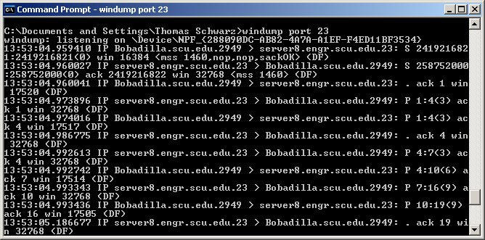
TCPDump Filters Example
Format 1: macro and value
“tcpdump port 23”
  Only displays packages going to or from port 23.

Slide 69
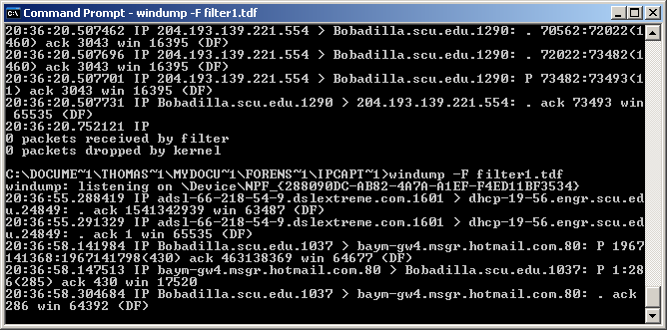
TCPDump Filters
Use –F filename to specify a file containing the filter.

Slide 70
What is Wireshark?
Remember: You must have a good understanding of the network before you use Sniffers effectively!
Formerly called Ethereal
An open source program
  free with many features
Decodes over 750 protocols
Compatible with many other sniffers
Plenty of online resources are available
Supports command-line and GUI interfaces
  TSHARK (offers command line interface) has three components
    Editcap (similar to Save as..to translate the format of captured packets)
    Mergecap (combine multiple saved captured files)
    Text2pcap (ASCII Hexdump captures and write the data into a libpcap output file)

Slide 71
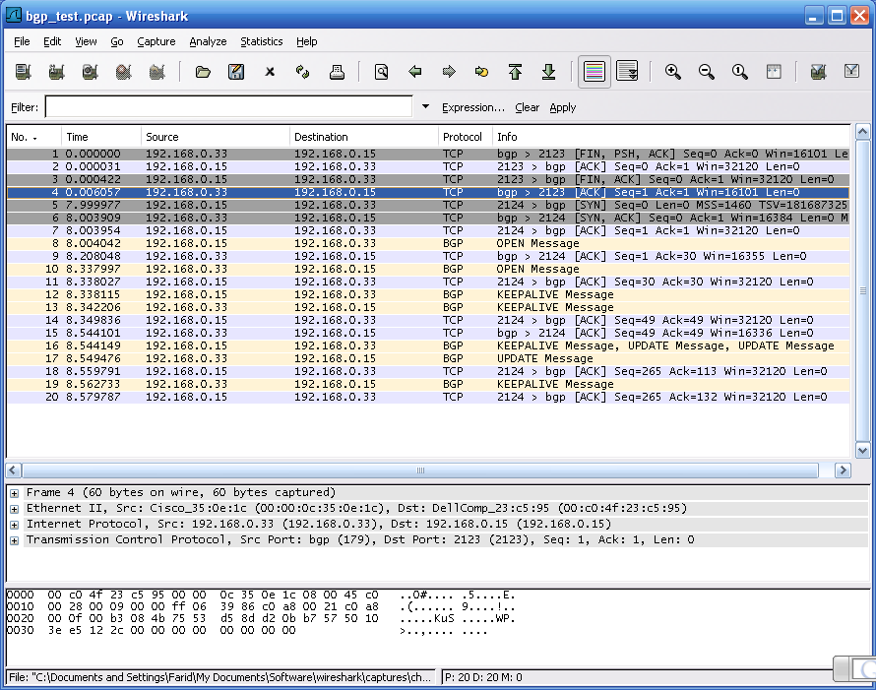
Wireshark Interface
Menu Bar
Tool Bar
Filter Bar
Summary
Window
Info
Field
Protocol Tree Window
Data View Window
Disp.
Info field

Slide 72
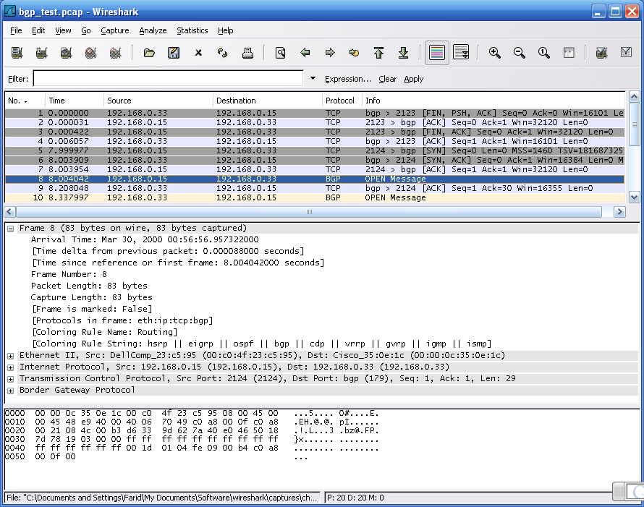
Packet number 8 – BGP (Boarder Gateway Prot)
Protocol Tree
Window: Details of the selected packet (#8)
Raw data (content of packet # 8)

Slide 73
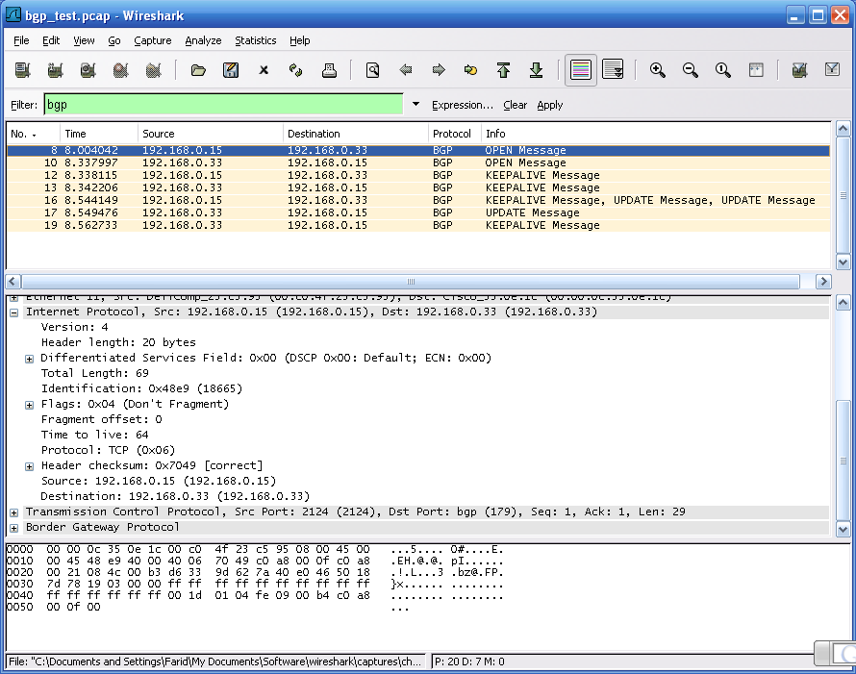
Filtering BGP packets only

Slide 74
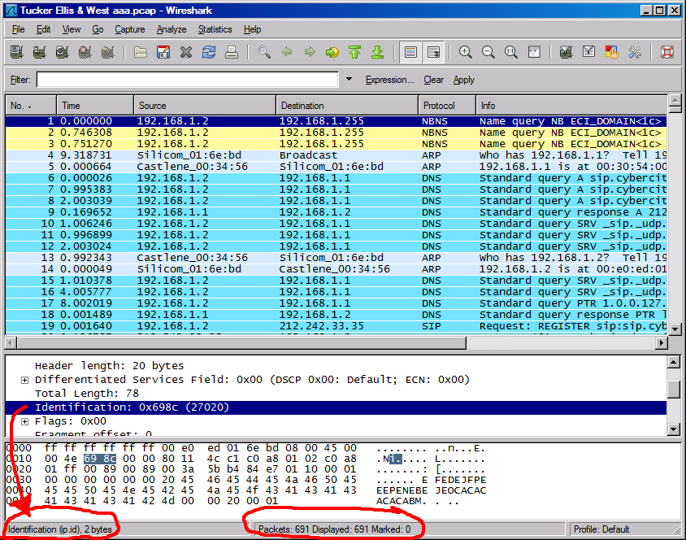
Status Bar

Slide 75
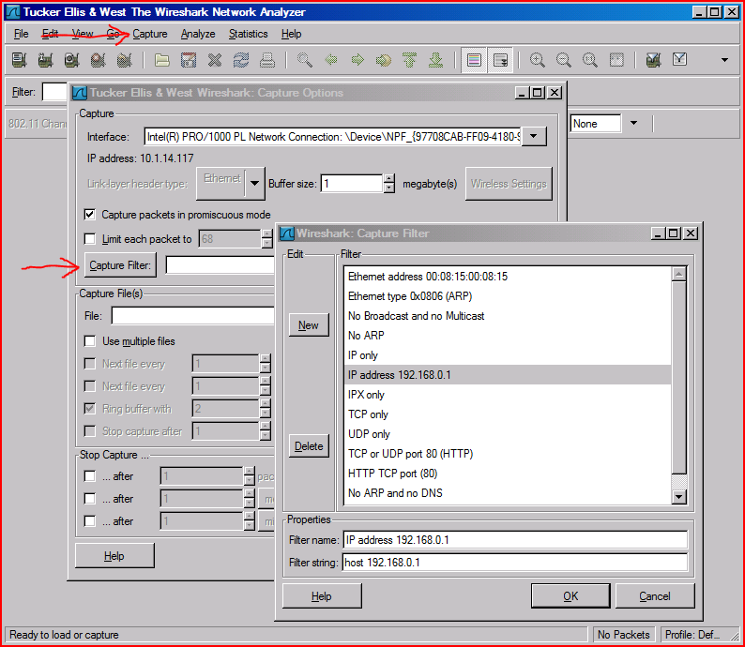
Capture Filter

Slide 76
Capture Filter examples
host 10.1.11.24
host 192.168.0.1 and host 10.1.11.1
tcp port http
ip
not broadcast not multicast
ether host 00:04:13:00:09:a3

Slide 77
Display Filters (Post-Filters)
Display filters (also called post-filters) only filter the view of what you are seeing. All packets in the capture still exist in the trace
Display filters use their own format and are much more powerful then capture filters

Slide 78
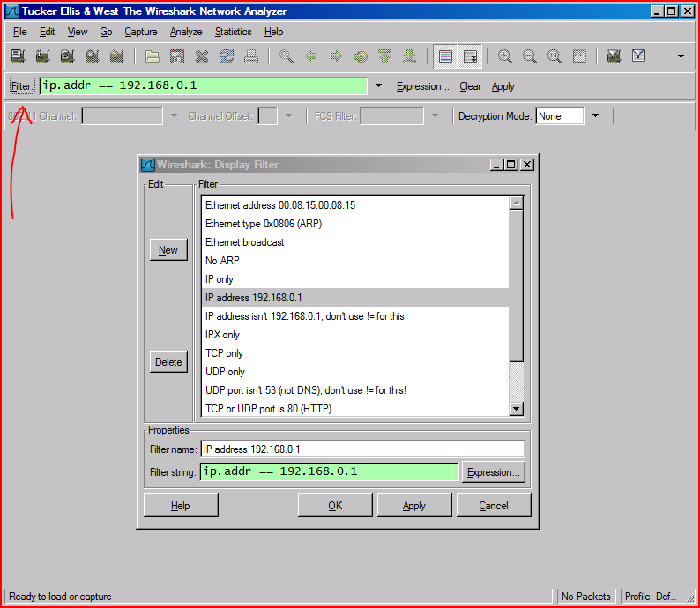
Display Filter

Slide 79
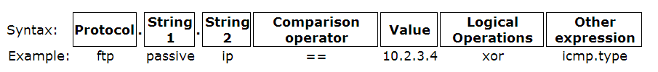
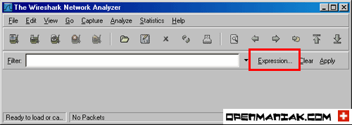
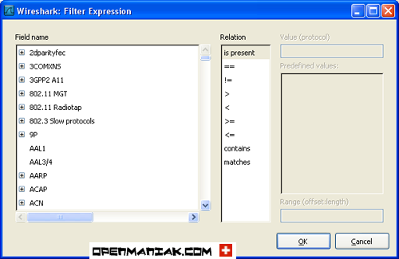
Display Filter

Slide 80
Display Filter Examples
ip.src==10.1.11.00/24
ip.addr==192.168.1.10 && ip.addr==192.168.1.20
tcp.port==80 || tcp.port==3389
!(ip.addr==192.168.1.10 && ip.addr==192.168.1.20)
(ip.addr==192.168.1.10 && ip.addr==192.168.1.20) && (tcp.port==445 || tcp.port==139)
(ip.addr==192.168.1.10 && ip.addr==192.168.1.20) && (udp.port==67 || udp.port==68)
tcp.dstport == 80

Slide 81
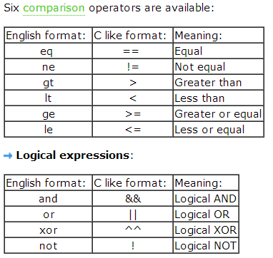
Display Filter Expressions
snmp || dns || icmp
  Display the SNMP or DNS or ICMP traffics.
tcp.port == 25
  Display packets with TCP source or destination port 25.
tcp.flags
  Display packets having a TCP flags
tcp.flags.syn == 0x02
  Display packets with a TCP SYN flag.
If the filter syntax is correct, it will be highlighted in green,
otherwise if there is a syntax mistake it will be highlighted in red.
Correct syntax
Wrong syntax

Slide 82
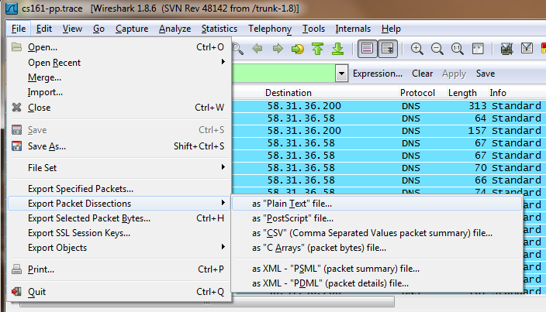
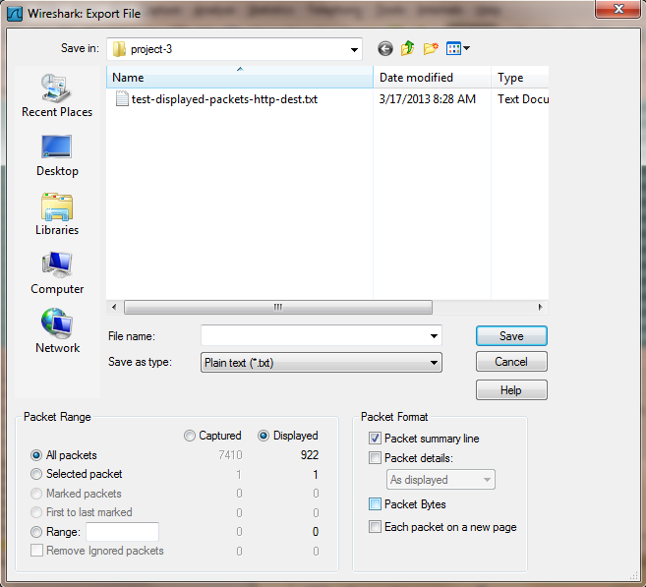
Save Filtered Packets After Using Display Filter
We can also save all filtered packets in text file for further analysis
Operation:
File→Export packet dissections
→as “plain text” file
1). In “packet range” option, select “Displayed”
2). In choose “summary line” or “detail”

Slide 83
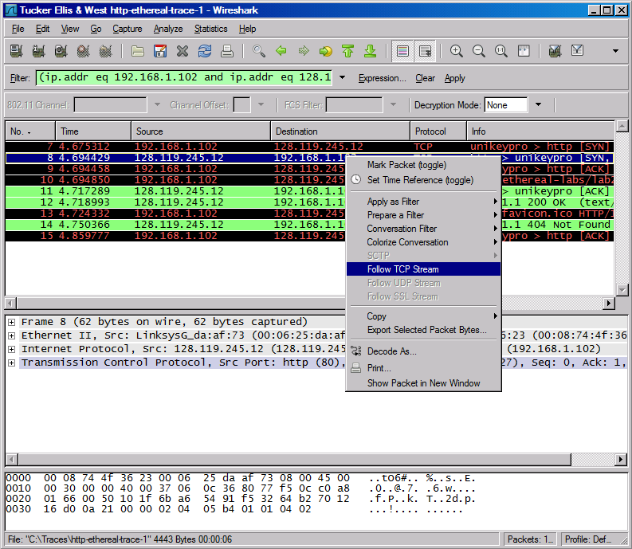
Follow TCP Stream

Slide 84
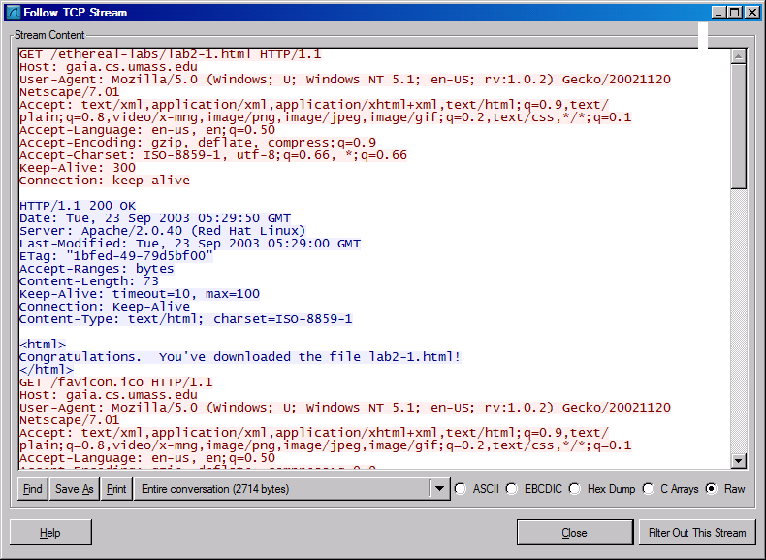
Follow TCP Stream
  red - stuff you sent blue - stuff you get

Slide 85
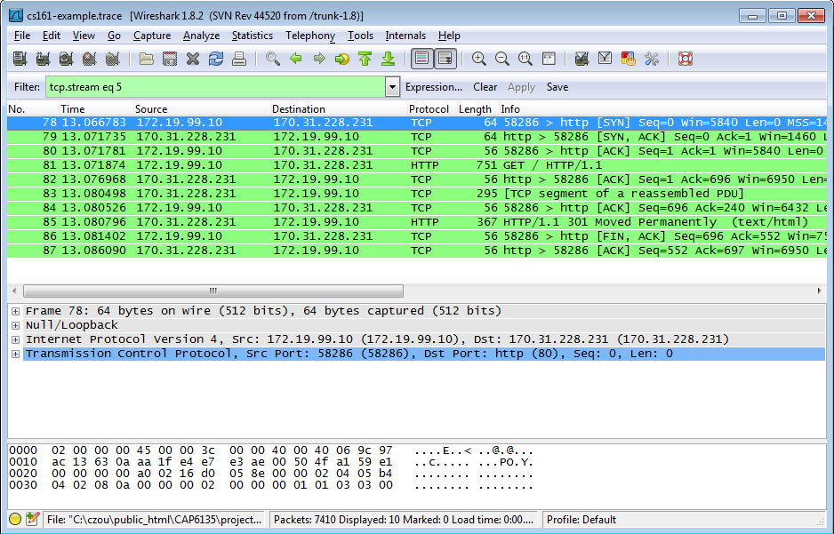
Filter out/in Single TCP Stream
When click “filter out this TCP stream” in previous page’s box, new filter string will contain like:
  http and !(tcp.stream eq 5)
So, if you use “tcp.stream eq 5” as filter string, you keep this HTTP session

Slide 86
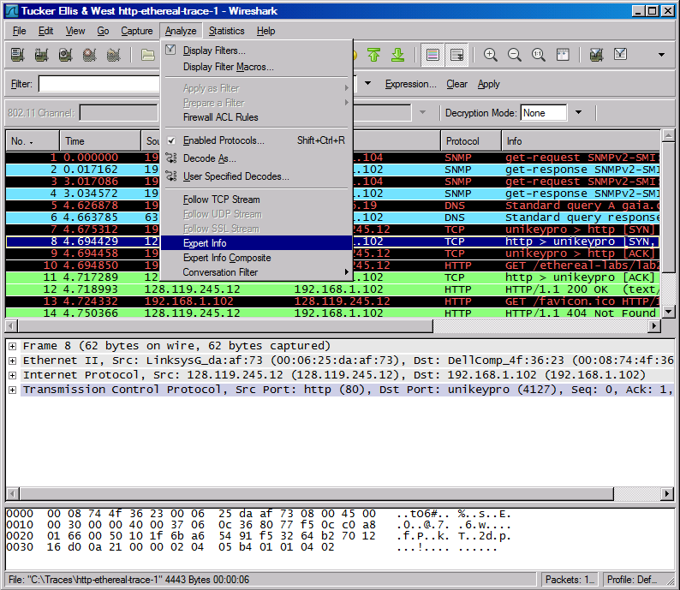
Expert Info

Slide 87
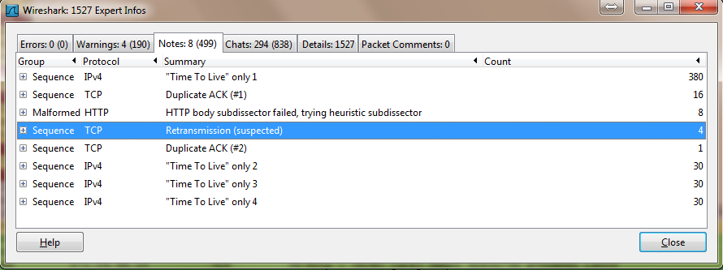
Expert Info

Slide 88

Conversations

Slide 89

Conversations

Slide 90

Use the “Copy” button to copy all text into clipboard
Then, you can analyze this text file to get what statistics you want

Slide 91

Find EndPoint Statistics
Menu “statistics” → “endpoint list” → “TCP”
You can sort by field
“Tx” : transmit “Rx” : receive

Slide 92

Find EndPoint Statistics
Use the “Copy” button to copy all text into clipboard
Then, you can analyze this text file to get what statistics you want

Slide 93

Flow Graphs

Slide 94

Flow Graphs
The “displayed packet” option could let you only
Show the flow of packets shown up
  for example, only display http traffic, then show
  The flow to analyze

Slide 95

Flow Graphs

Slide 96

Export HTTP

Slide 97

Export HTTP Objects

Slide 98

HTTP Analysis

Slide 99


HTTP Analysis – Load Distribution
Click “Create Stat” button
You can add “filter” to only
Show selected traffic

Slide 100

HTTP Analysis – Packet Counter

Slide 101

HTTP Analysis – Requests

Slide 102
Improving WireShark Performance
Don’t use capture filters
Increase your read buffer size
Don’t update the screen dynamically
Get a faster computer
Use a TAP
Don’t resolve names

Slide 103
Post-Processing Text File
For saved text-format packet files, further analysis needs coding or special tools
One useful tool on Unix: Grep
  On Windows: PowerGrep http://www.powergrep.com/
  Command-line based utility for searching plain-text data sets for lines matching a regular expression.

Slide 104
Basic usage of Grep
Command-line text-search program in Linux
Some useful usage:
  Grep ‘word’ filename # find lines with ‘word’
  Grep –v ‘word’ filename # find lines without ‘word’
  Grep ‘^word’ filename # find lines beginning with ‘word’
  Grep ‘word’ filename > file2 # output lines with ‘word’ to file2
  ls -l | grep rwxrwxrwx # list files that have ‘rwxrwxrwx’ feature
  grep '^[0-4]‘ filename # find lines beginning with any of the numbers from 0-4
  Grep –c ‘word’ filename # find lines with ‘word’ and print out the number of these lines
  Grep –i ‘word’ filename # find lines with ‘word’ regardless of case
Many tutorials on grep online
  http://www.cyberciti.biz/faq/howto-use-grep-command-in-linux-unix/
  http://www.thegeekstuff.com/2009/03/15-practical-unix-grep-command-examples/

Slide 105
On-line Wireshark Trace Files
Public available .pcap files:
  http://www.netresec.com/?page=PcapFiles
http://www.tp.org/jay/nwanalysis/traces/Lab%20Trace%20Files/
Wiki Sample capture
  https://wiki.wireshark.org/SampleCaptures

Slide 106

Now Let’s Start Our Journey With the Virtualization Lab

Slide 107
Virtualization Software
Runs operating systems in fully emulated environment
  Vmware (Vmware Inc.)
  VirtualBox (Oracle)
  Virtual PC (Microsoft)
  Xen (open source project)

Slide 108
Virtualization Terminology
Host OS – running on physical computer
  Only one host OS may run at a time
  “Hosts” the other running operating systems
Guest OS – running in emulated environment
  Can run multiple guests at the same time
  Guest thinks it is running on actual hardware
Virtual machine – set of files that make up a guest OS

Slide 109
Virtual Machine Advantages
Can distribute a pre-configured OS
  Run VM, install/configure it, then export to another VM image
Easy to create multiple snapshots
  If something goes wrong, roll-back to a previously saved snapshot
Portable
  Run on any host OS
  Store on portable hard drive or laptop

Slide 110
Virtual Machine Advantages
Sandbox
  Does not affect anything on host OS
Networked
  Can access over the network

Slide 111
Guest OSes ---- Linux
Kali Linux
  Penetration testing preconfigured
  A lot of hacking tools preinstalled
  https://www.offensive-security.com/kali-linux-vmware-virtualbox-image-download/
  Root Name: root password: toor
Metasploitable
  An intentionally vulnerable Linux VM
  Security training, penetration testing
  https://sourceforge.net/projects/metasploitable/files/Metasploitable2/
  The default login and password is msfadmin:msfadmin

Slide 112
Guest OSes ---- Windows
Windows VMs
  Microsoft has made available a number of VMs that can be downloaded to test Microsoft Edge and different versions of IE.
  Download from: https://dev.windows.com/en-us/microsoft-edge/tools/vms/
  Currently it has Win7, Win8, Win10
  Under the webpage, “Choose your OS” means your host OS
  These virtual machines expire after 90 days.
    setting a snapshot when you first install the virtual machine which you can roll back to later.

Slide 113

Install VM Images in VirtualBox
https://drive.google.com/drive/folders/13r5Z-TDdB1SpSe9JWozSItAfLMlRE68v?usp=sharing
For VM images with .ova file type
  VirtualBox menu:
    “File”→”Import Appliance”
    Choose the *.ova image file to import
    the VM image
    Just use the default configurations

Slide 114

Importing Alice, Mallet, Bob Image
Take a while, so be patient…. ( a few minutes)

Slide 115

Importing Alice, Mallet, Bob Image

Slide 116

The Lab Environment
Three preconfigured virtual machines, alice, bob, and mallet

Slide 117



The Lab Environment
Alice: typical Linux desktop operating system, namely Ubuntu 10.04.1
Bob: Debian server operating system and is configured as a typical Linux server. The server runs a set of services including FTP, HTTP, and SSH servers.
Mallet: Linux desktop operating system (Ubuntu 10.04.1 lucid)

Slide 118

Networking in VirtualBox
VirtualBox provides the following networking options:
We will introduce:
  NAT, NAT Network, Bridged Adapter, Host-only Adapter

Slide 119
Host-only Networking
Host-only networking: This creates a network that contains the host and a set of virtual machines. No physical interface is needed; instead a virtual interface (such as a loopback interface) is created on the host.
This is a kind of hybrid mode between bridged and internal networking modes, i.e., the virtual machines can talk to each other (internal networking) and can talk to the host (bridged networking).
However, there is no need for a physical interface as in bridged networking, and the virtual machines cannot talk to the outside world since they are not connected to the physical interface.

Slide 120
MAC address for the Ethernet interface
Alice: 08:00:27:ED:5B:F5
Bob: 08:00:27:2A:AB:8D
Mallet: 08:00:27:FB:3C:18

Slide 121


IP Address Checking Tool
In Windows, run “ipconfig” under “cmd” window
In Linux, run “ifconfig” in terminal

Slide 122

Networking Diagnosis Tool
Use “Ping” command to check if a host is reachable
  In Windows, run “ping x.x.x.x” under “cmd” window
  In Linux, run “ping x.x.x.x” in terminal
    Use CTRL+C to stop the pinging action

Slide 123
VirtualBox Networking Setup
Objective:
  Let multiple VMs in the same LAN
    This LAN is private, cannot be connected from outside (for security purpose)
  Each VM has Internet access
    So that we can download/install software on them
Two types of networks:
  (Bridged Adapter) Host machine and VMs are in the same LAN
  (NAT Network) Guest VMs in the LAN, cannot see host OS

Slide 124

Networking in VirtualBox: NAT
Default configuration
Virtualbox generates NAT routers
  One NAT router for each VM
Simplest, no configuration at all
Issues:
  Each VM in its own private LAN, cannot see each other
VirtualBox
Network Engine
NAT routers
VM1
VM2
VM3

Slide 125

Networking in VirtualBox: Bridged Adapter
Each VM requests its IP address just like the host OS to the default DHCP server
  All VMs and host OS are in the same LAN, so they can talk to each other
  Your home WiFi router most likely will support this
DHCP/NAT server (e.g., wifi router)
Host OS
VM2
VM1

Slide 126
File Transfer between VM and Host OS
Use online server for file upload/download
  Upload to an online storage (such as Google Drive, MS Onedrive)
  Download to the host OS or VM
2. Virtualbox support ‘drag and drop’ file transfer between host OS and a VM OS
  Run the Kali Linux VM under virtualBox
  Configure virtualBox menu “Devices” → “Drag and Drop” → enable “Bidirectional”
  In Kali, open “file folder” icon, in the host OS, open a folder window
  Now you can drag/drop files between host and VM

Slide 127

Shared Folder in Linux VM
3. VirtualBox supports “shared folder” between host OS and VM
Run the Kali Linux VM under VirtualBox
Configure virtualBox menu “Devices” → “shared folders” → “Shared folder setting…”→ click the “+” button
In the Folder Path field, choose “Other…” to add a host OS folder as the shared folder (e.g., “Download”)
In Linux VM:
mkdir shared
mount -t vboxsf Download ~/shared
Now VM’s “~/shared” would be identical to the “Download” folder on host OS

Slide 128
Questions?

